Slide 1
Career Plan 12
Student Guide
Resume
Job Application

Slide 2
The Basics
All Seniors must complete the Resume Requirement.
All Seniors must complete a Job Application.
The Resume will be created in Naviance under the “About Me” tab.
The Job Application will be uploaded to Naviance.
Advisory teachers will check completion by the assigned due date.
Career Plan credit (0.5) is required for graduation.

Slide 3
Help & Resources
Career Plan 12 Resources available on CBSD website: http://www.cbsd.org/Page/289
Videos featuring step-by-step instructions for
  completing your Resume: http://www.screencast.com/t/2T7GILEQq
  completing your Job Application: http://www.screencast.com/t/nX50ShTwQaYU
  uploading your completed Job Application: http://www.screencast.com/t/4h2yf7XYrXkK

Slide 4

Step One: Create Resume in Naviance

Slide 5
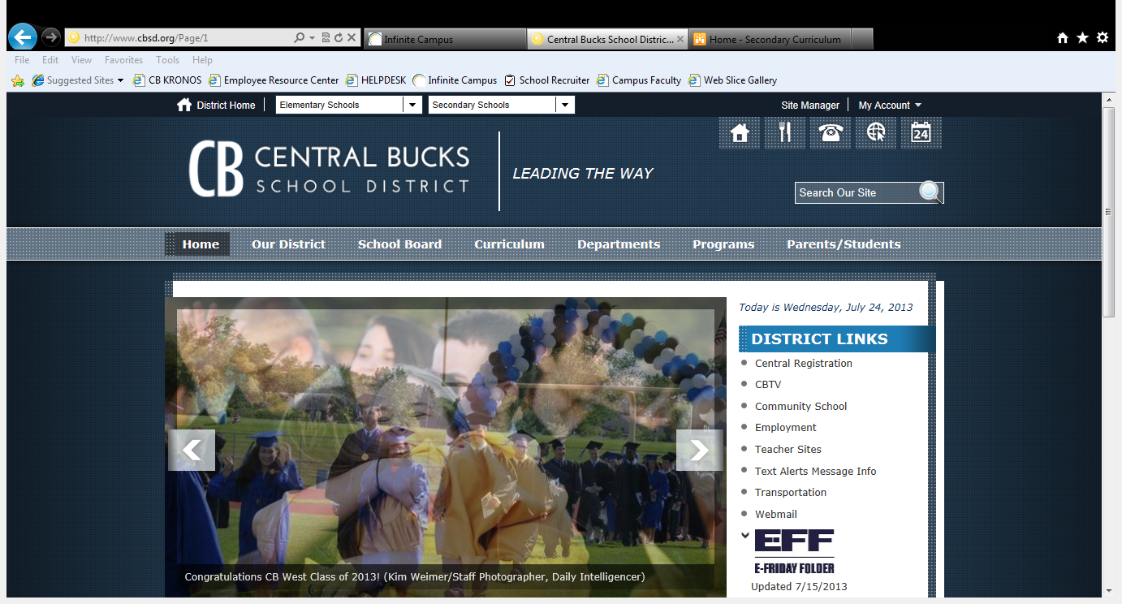
Logging on to Naviance…
Logging on to Naviance…

Slide 6
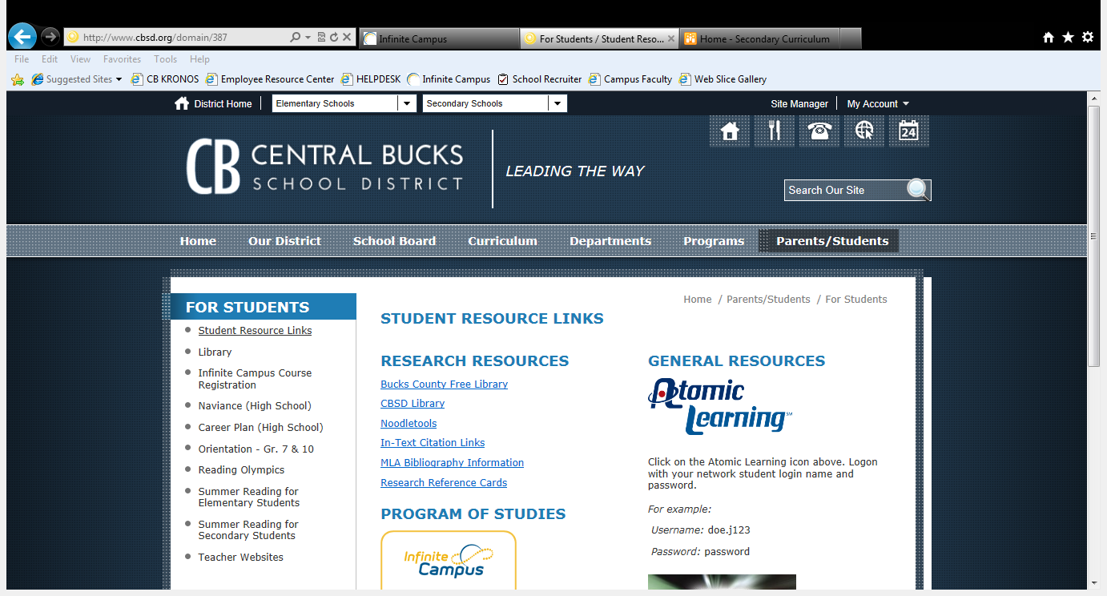
Under For Parents / For Students, Choose For Students

Slide 7
Click on Naviance (High School)

Slide 8
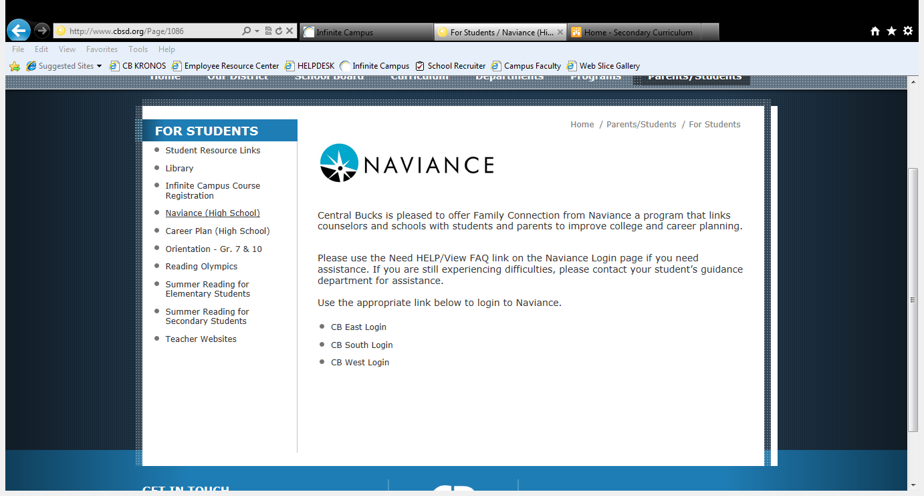
Choose Your School
Choose CB East

Slide 9
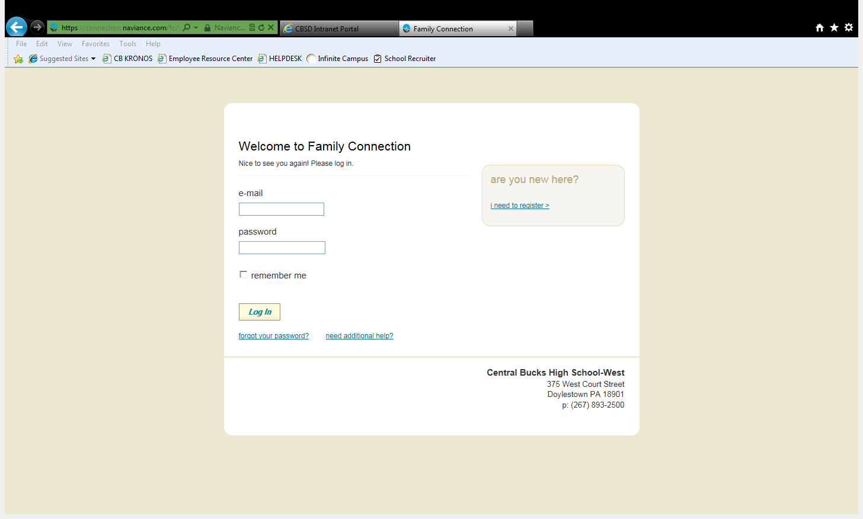
Go to email / password boxes
NOTE: IF YOU HAVE FORGOTTEN YOUR PASSWORD OR HAVE CHANGED YOUR EMAIL, PLEASE REPORT TO THE HOUSE OFFICE!

Slide 10
Click on Log In

Slide 11
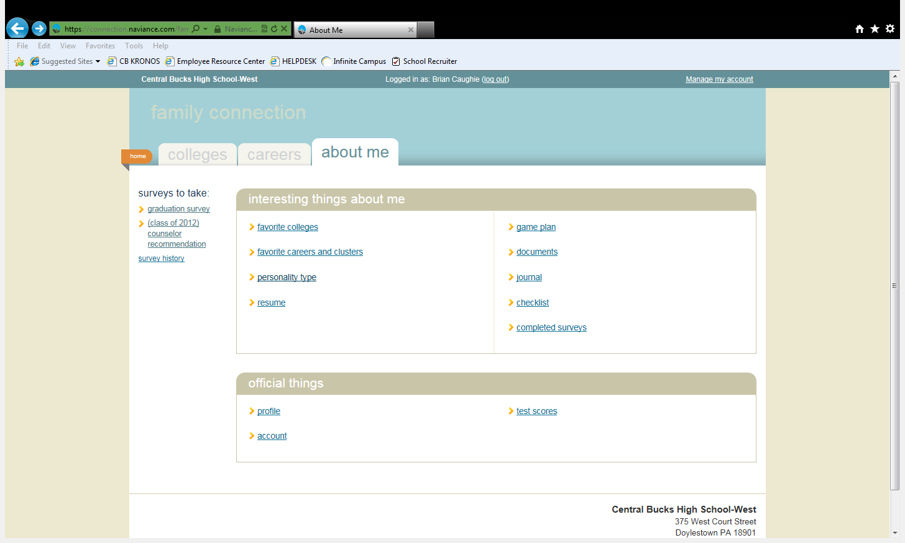
Sophomores
—Do What You Are
Click on “Resume” tab

Slide 12
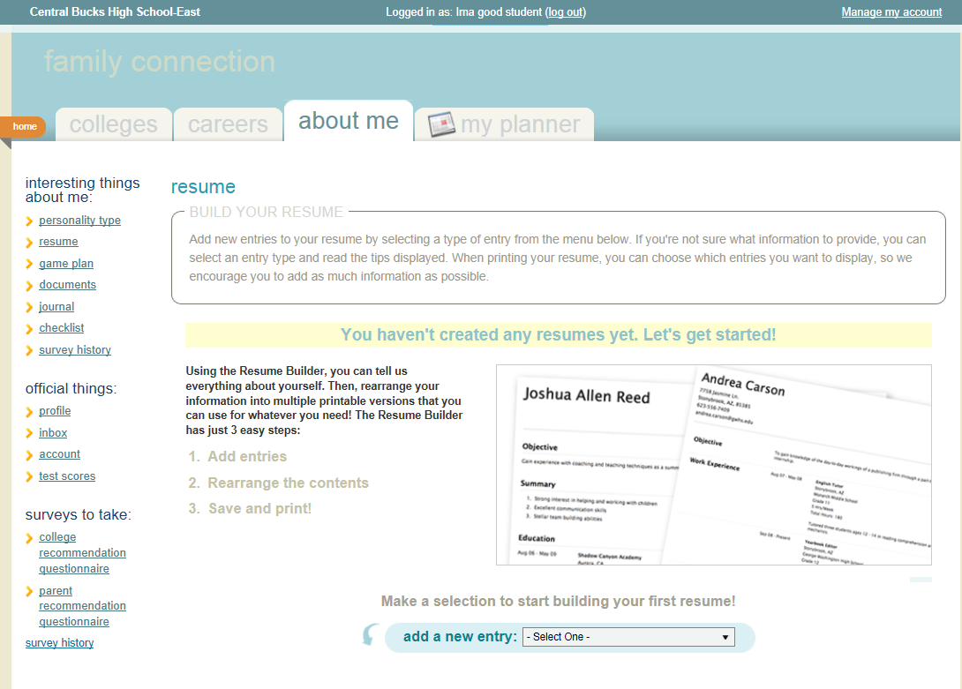
Click on “Resume” tab

Slide 13
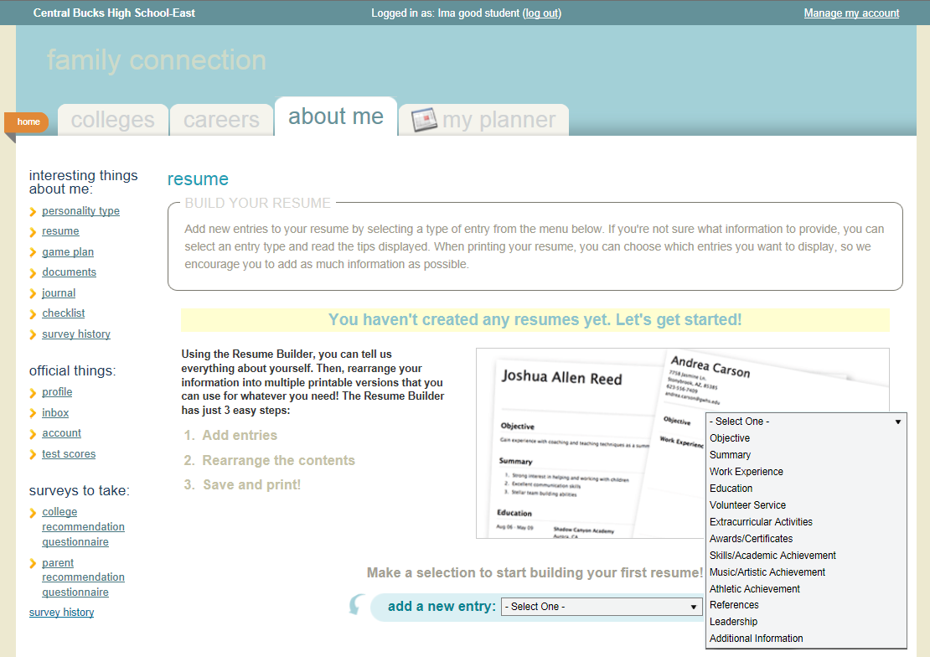
From the drop down, you MUST complete entries for: OBJECTIVE, EDUCATION, and REFERENCES

Slide 14
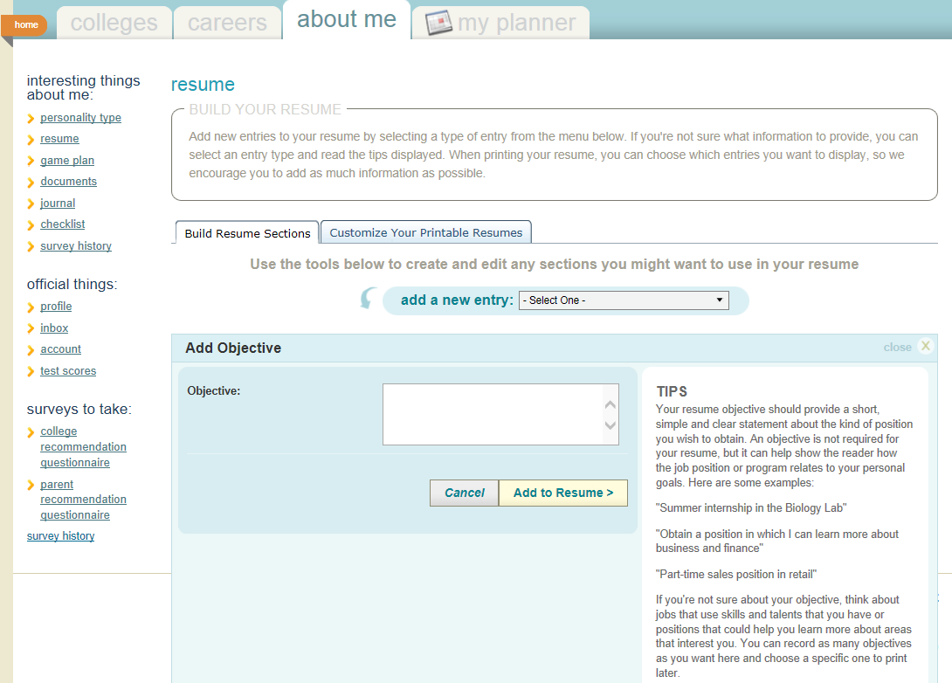
Using OBJECTIVE as an example, enter the requested information in the box

Slide 15
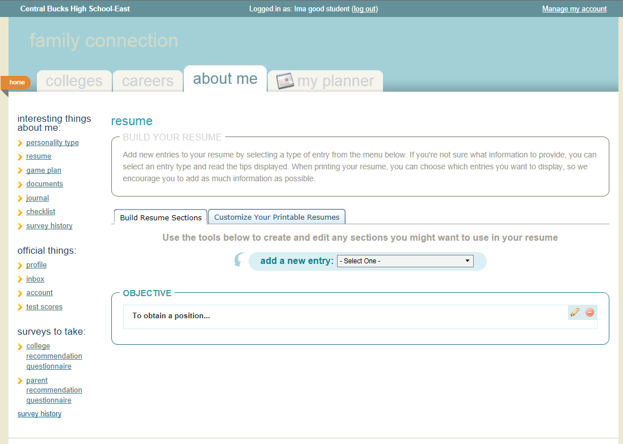
After you enter the information in the box, you will be able to see your entry on your resume.

Slide 16
In addition to the required entries , you must complete two additional entries

Slide 17
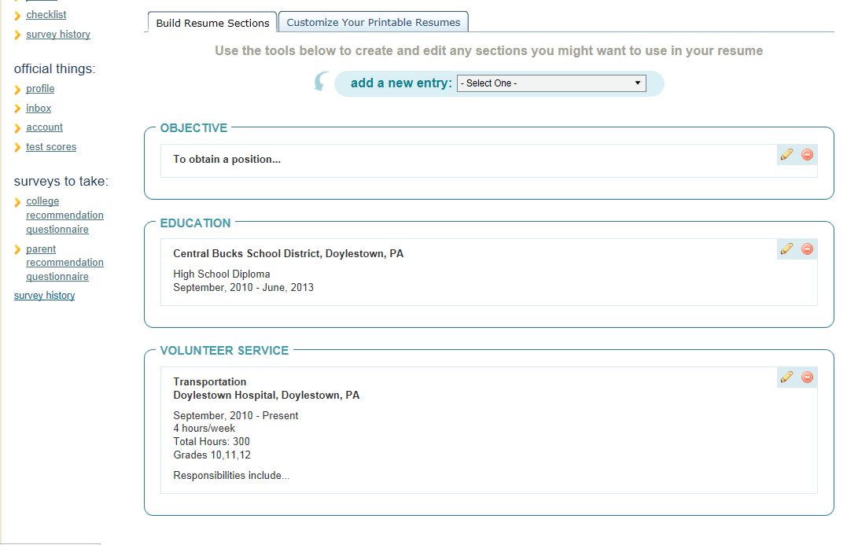
Your resume will begin to take shape…

Slide 18
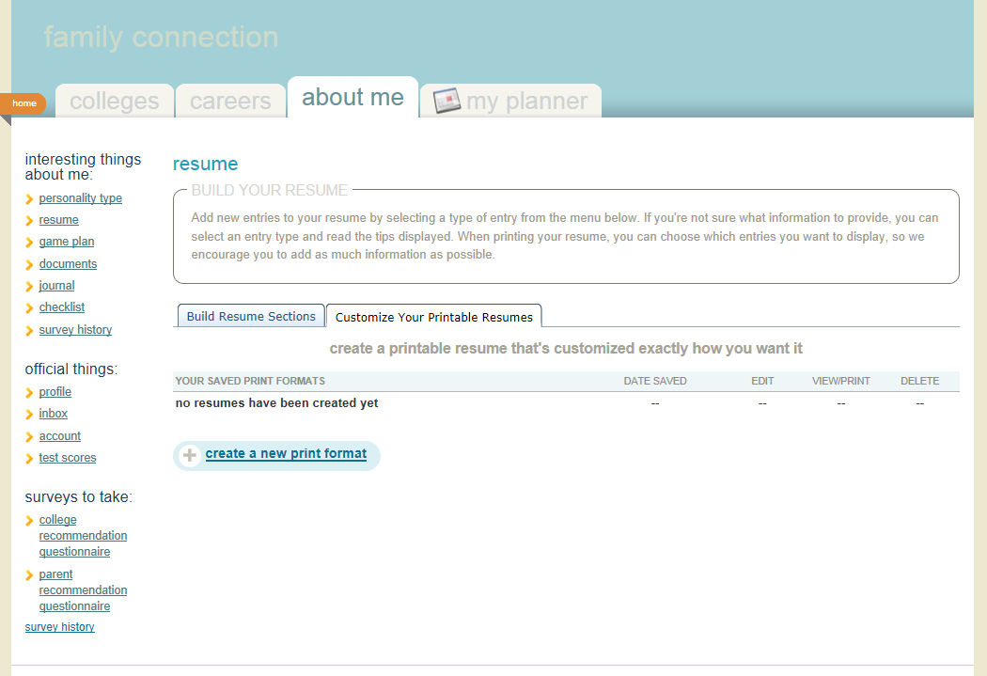
After you’ve completed the entries, you can choose to print your resume through Customize Your Printable Resume tab.

Slide 19
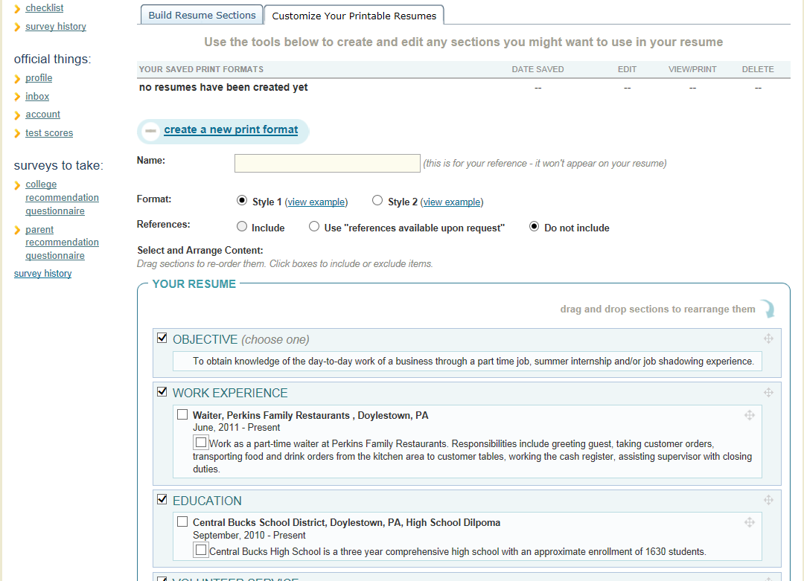
Check all of the entry boxes that you would like to show in your resume.

Slide 20
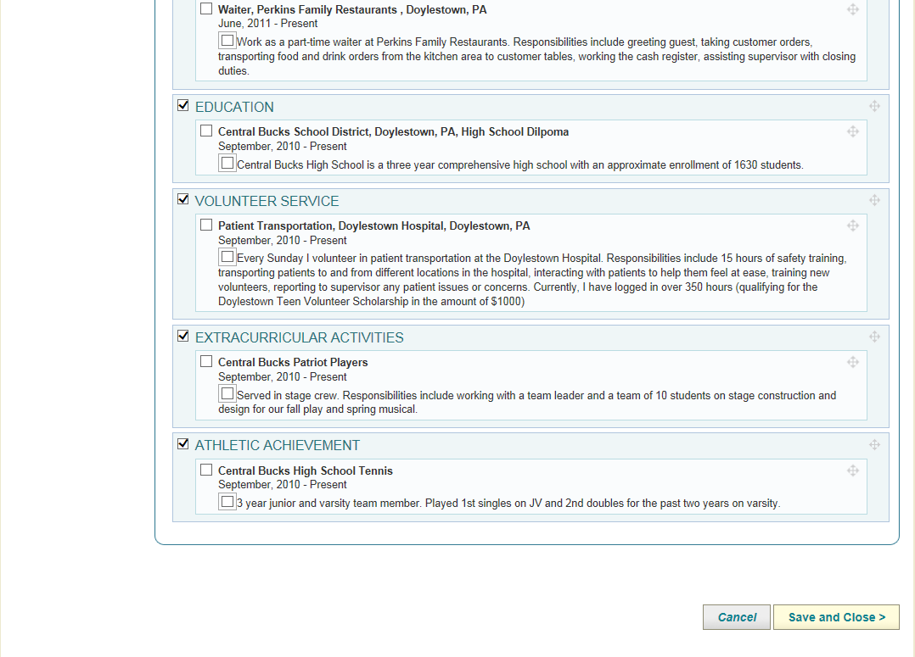
Click Save and Close at bottom of screen.

Slide 21
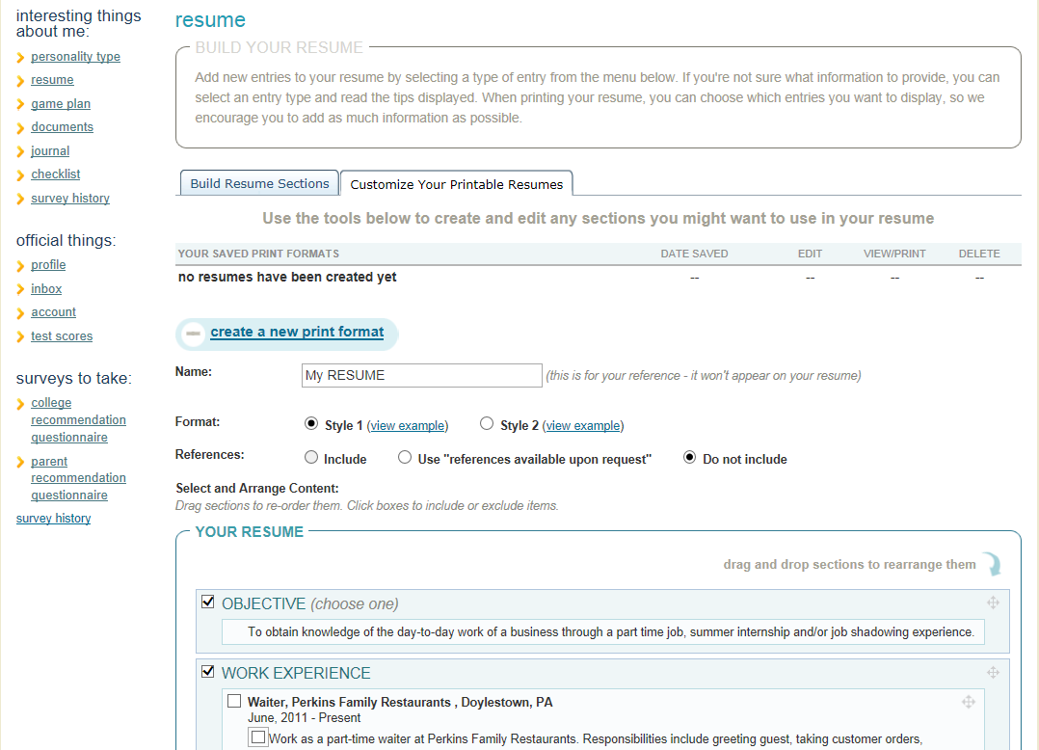
Title your resume and choose a format.

Slide 22
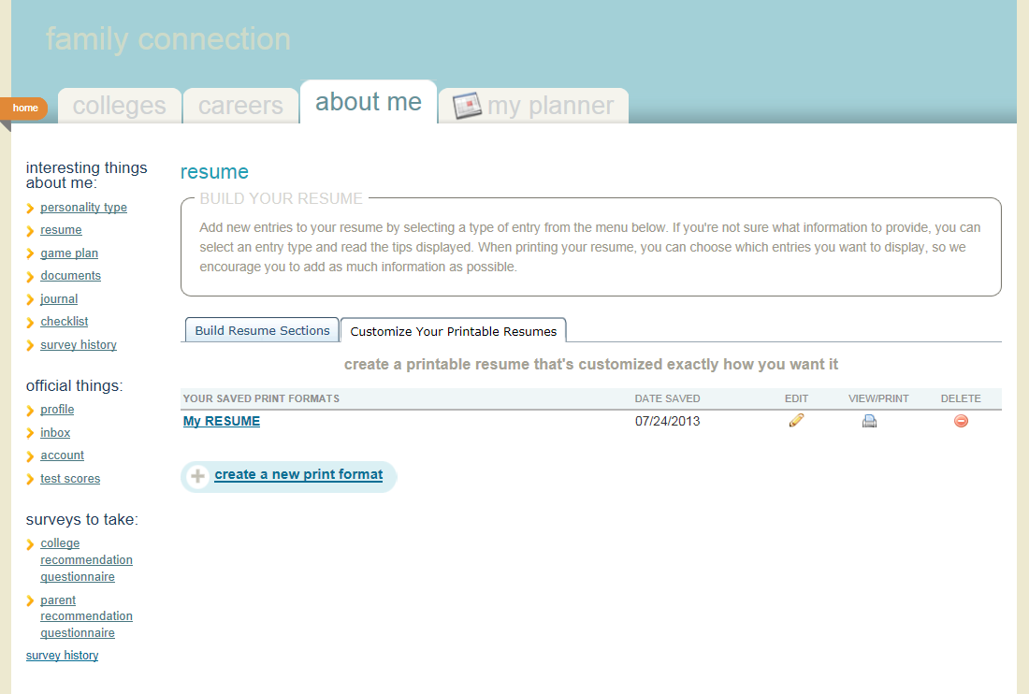
Your resume is ready to be printed should you choose to do so. You are NOT required to print your resume.

Slide 23
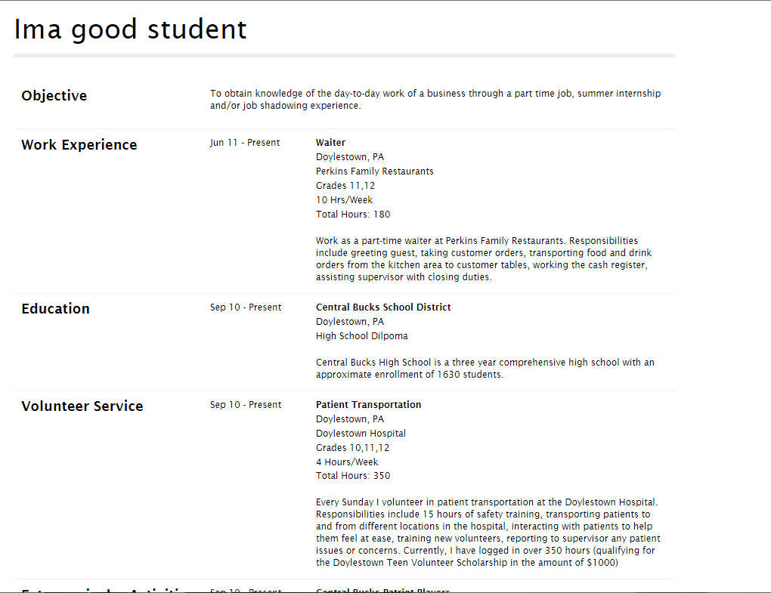
This is an example of a completed resume

Slide 24

Step Two: Complete Job Application

Slide 25
1. Download job application template.
Go to your school’s home page
Click “Career Plan”. This takes you to Career Plan Webpage.
Click on “Career Plan 12 Job Application”
Fill out, save as your own Word Document
Upload on “Journal Tab” in Naviance

Slide 26
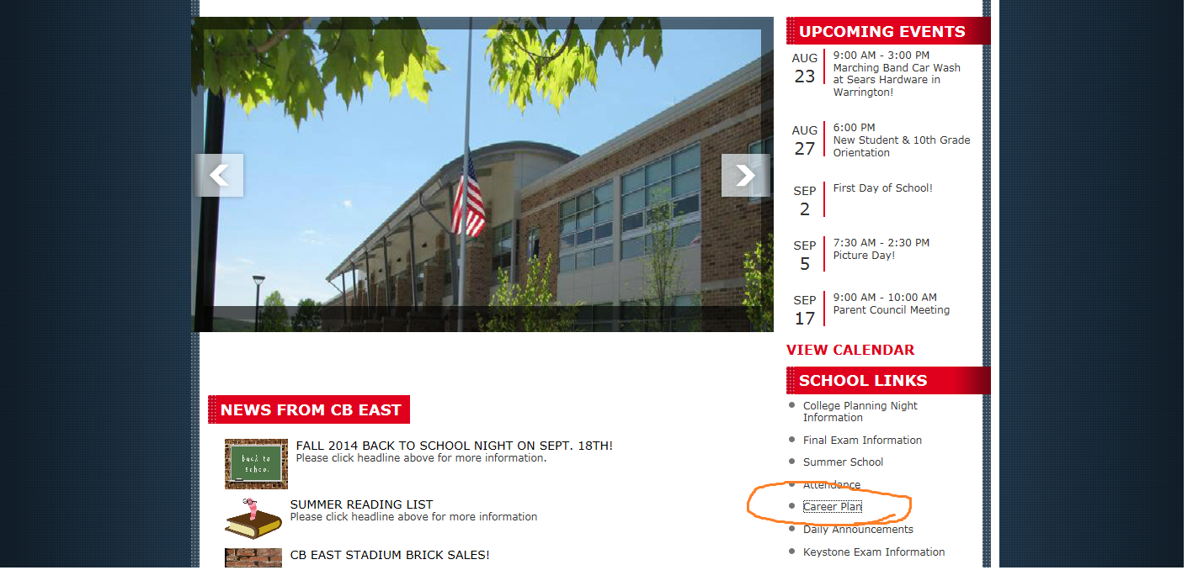
Click on Career Plan from the CB East homepage

Slide 27
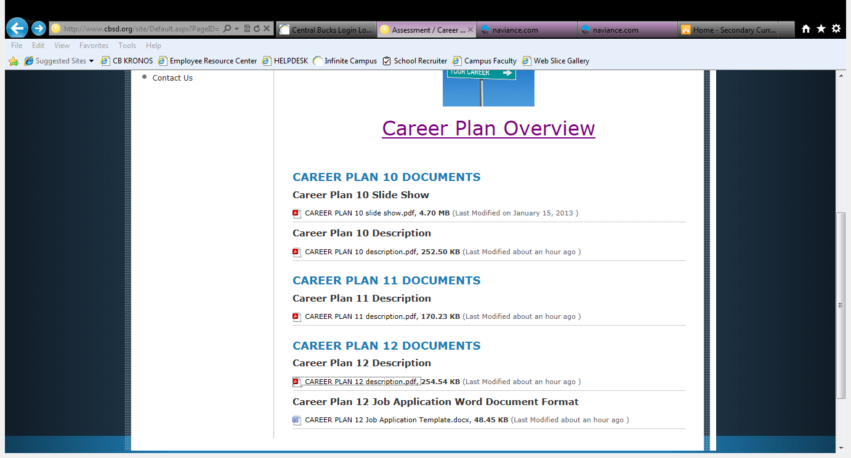
Click on Career Plan 12 Job Application template

Slide 28
Fill out application, and save as Word Document
Upload to Journal tab in Naviance

Slide 29
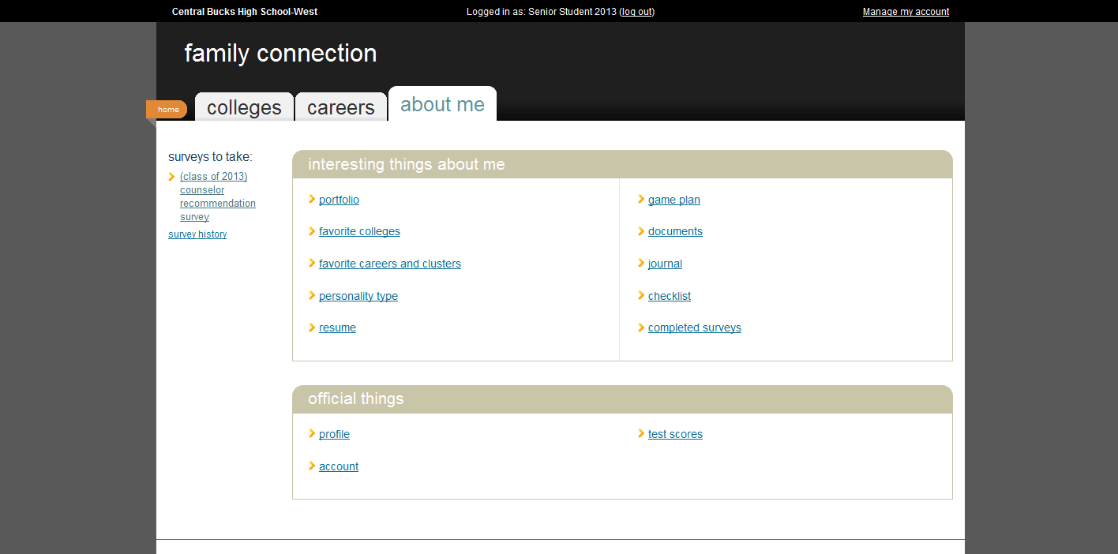

Slide 30
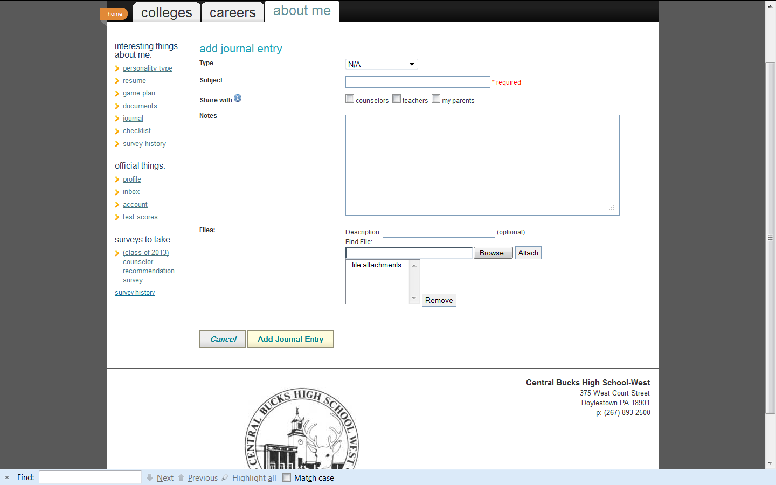
Type “CP12 Job App”
Check boxes for Counselor and Teacher
Browse to find and attach your Job App
Click Add Journal Entry

Slide 31
Due Dates
Resume (uploaded on Naviance)—due Thursday, October 30
Job application (uploaded on Journal Tab on Naviance)—due Thursday, October 30
Uploads will be checked in advisory

